Slide 1
Animations Documentation
Slap
RPA Arm Swings
Report In
Parrot
Chicken Dance (Long)
Fist Pump
Fist Bump
Firework

Slide 2
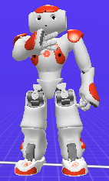
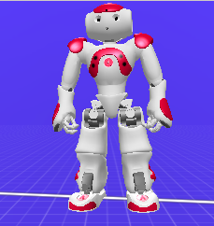
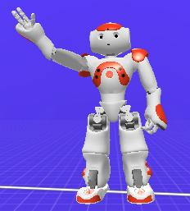
Slap
Medium
Fast
Says “Quiet Jacob”
Medium Hold
Slow

Slide 3
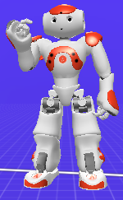
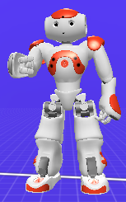
RPA Arm-Swings
Medium
Medium
Medium
Medium
3x Says “Rock” “Paper” “Scissors” One each time.

Slide 4
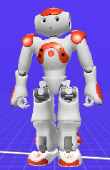
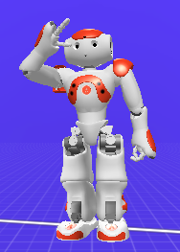
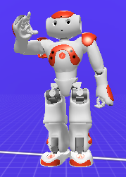
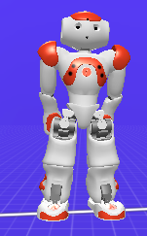
Report In
Walks Forward 35cm
Slow
Medium
Fast
Long Hold and Says “NAO ready for demonstration, sir!”
Medium (Many small moves)
Medium
Back to standing.
Short Hold
Long Hold

Slide 5
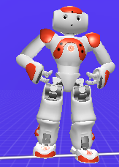
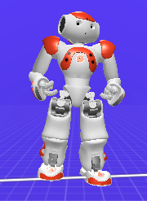
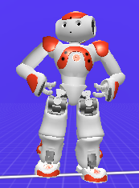
Parrot
Medium
Fast
Fast
More random head movements with arm flap
Plays Parrot audio

Slide 6
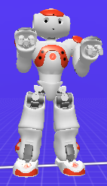
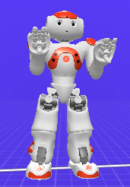
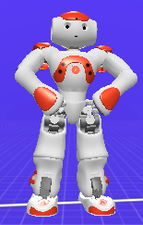
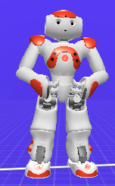
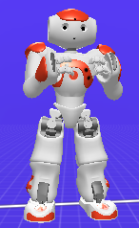
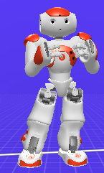
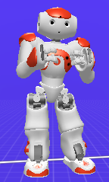
Chicken Dance Long
Playing Chicken Dance Music
Fast
Fast x4
Fast
Fast x4
Fast
Fast
Fast

Slide 7
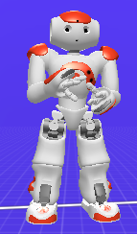
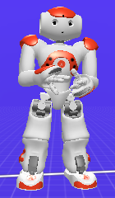
Chicken Dance Long Cont.
Playing Chicken Dance Music
Fast
Fast
Fast x2
Fast x4
Back to the beginning at this point. The whole thing repeats four times then returns to standing.

Slide 8
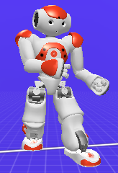
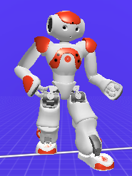
Fist Pump
Slow
Fast
Says “Woo hoo! Good Job!”
Slow

Slide 9
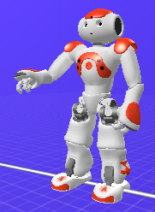
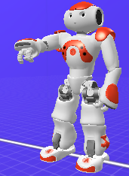
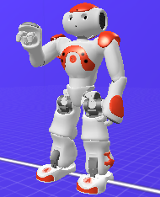
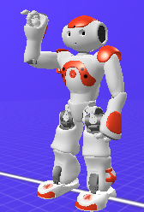
Fist Bump
Medium
Medium
Medium
Says “Fist Bump”
Medium Hold
Says “Badaladala”
Medium
Medium

Slide 10
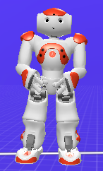
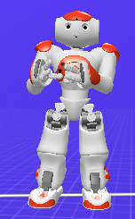
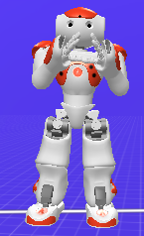
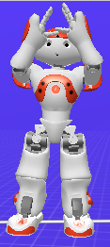
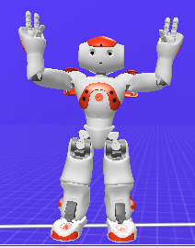
Firework
Plays Firework Sound
Medium
Medium
Medium
Medium
Medium
Slow

